Slide 1


USB HUB for Retail IOT
Presented by
Sri Ram Reddy
Keerthana Reddy Varakala
D Maalavya Mani

Slide 2
Team Introduction
Sri Ram Reddy
Keerthana Reddy Varakala
D Maalavya Mani

Slide 3
Problem Statement
Hardware abstraction and Ease of upgrade:
There are several POS solutions working for small scale , large scale and very large scale business.
The problem is the graceful use of a device for the abstraction of hardware logic(peripheral devices) from POS using standard REST protocols.
Peripherals for a Point of Sale, are very localized to the implementation, and are hard to switch across the several available POS Solutions.

Slide 4
We have an IOT driven solution

Slide 5
Introduction\Proposed solution
We programmed a Single board computer to act as a Smart HUB that will abstract the peripheral specific logic, so that the peripherals can be shared across the Retail POS Solutions.
The idea is that the peripheral would send the data generated to the HUB, and the HUB would transmit the peripheral specific data to the different POS.
Several available POS, would only need to talk to the HUB so as to obtain the needed info and perform the needed operation.
Peripherals would be : barcode scanners, Weighing Scales, Customer Display, mouse, keyboard etc.
Technologies Used
SOFTWARE:
IOT
Python
PHP
C#
Linux
Raspbian
HARWARE:
Raspberry pi
Barcode Scanner

Slide 6
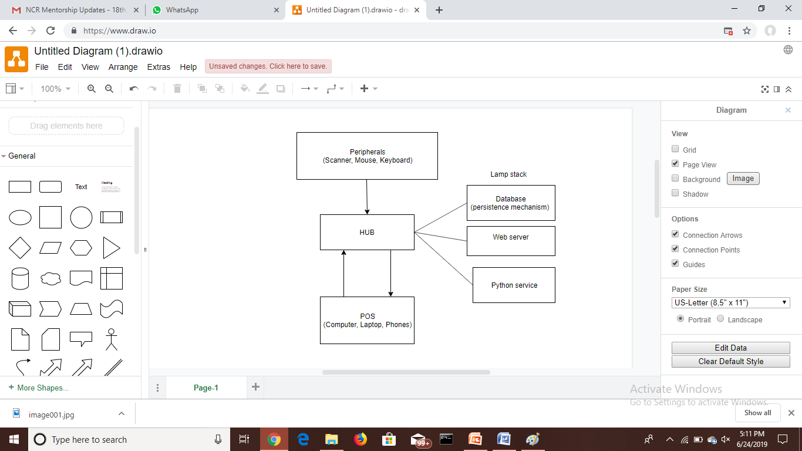
Flowchart

Slide 7
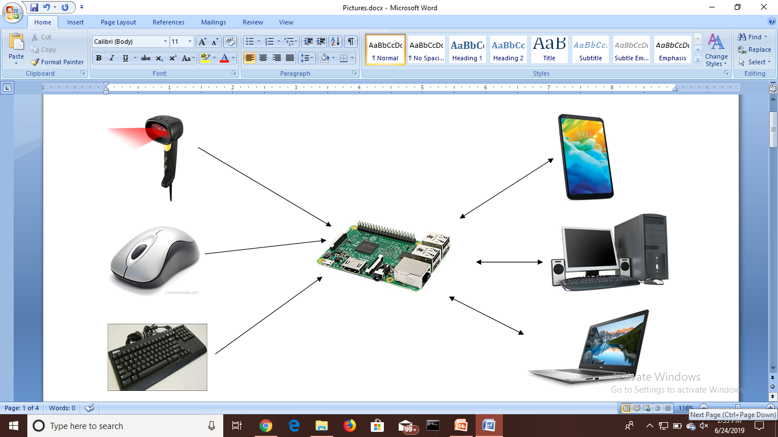
Architecture
Peripherals
POSs
HUB

Slide 8
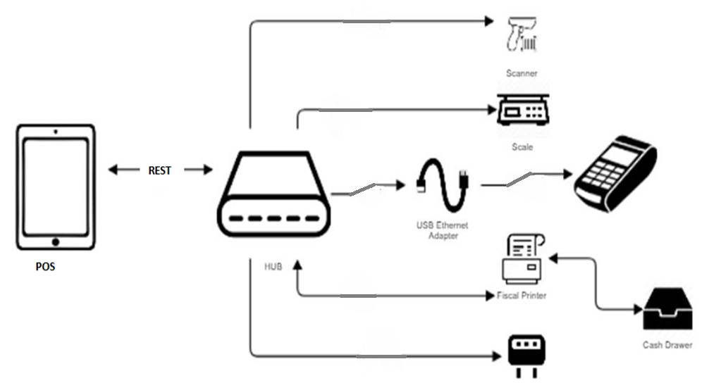

Slide 9
Demo / Prototype

Slide 10
Benefits
Abstracting hardware dependency reduces development work needed on peripheral integration.
Device Compatible (both peripherals and POSs)
Remote access of peripherals (through network enabled hub)
Supports different POS solution through REST calls (peripherals are same)
Portable

Slide 11
Future Scope
Device health (redundancy i.e. multiple instances)
Supporting several REST APIs.
Present → pull model, future → push model

Slide 12
THANK YOU

